Slide 1

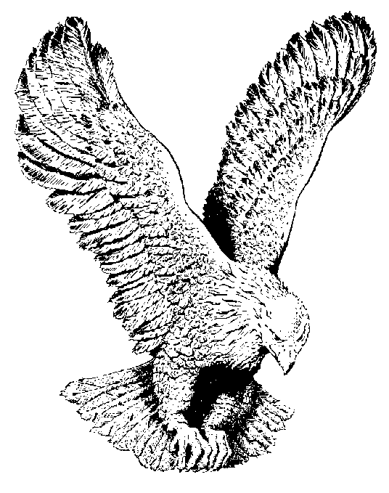
CASTING CROWNS
Casting crowns lifting hands,
Bowing hearts
Is all we’ve come to do (2X)
Adonai Adonai Adonai,
You reign on high,
We will rise in your name,
Adonai, you reign on high

